Slide 1

For independent therapists — patient records, scheduling and billing under one roof.
Built by Ashupriya Sadanande

Slide 2
SECTION 01 · PROBLEM
01
The Problem & The User
Who is your user?
Independent therapists running a solo practice — no clinic, no admin staff, no shared software.
What is the pain, in one sentence?
Patient records, scheduling, and billing live in three disconnected places — a notebook, WhatsApp, and a spreadsheet — so every new booking risks a double-booked slot and every invoice is manual arithmetic.
What do they do today, and why does it fall short?
They juggle phone calls or WhatsApp for scheduling, a notebook for session notes, and manual invoice templates for billing — nothing talks to each other, so double-bookings and billing errors are routine.

Slide 3
SECTION 02 · INTENT
02
User Intent
“When I ____, I want to ____, so that ____.”
“When a client walks in or calls to book a session, I want to instantly see my real availability and lock in a slot, so that I never double-book and can focus on the client instead of my calendar. When a session ends, I want an accurate invoice generated from the client's profile, so that billing takes minutes instead of manual math.”

Slide 4
SECTION 03 · SOLUTION
03
What I Built
Product summary (3–4 sentences):
Auralyn is a practice-management dashboard built for independent therapists. It brings patient records, appointment scheduling, and billing into one connected system, so a walk-in booking and a patient's own booking write to the exact same calendar and can never clash. Every new patient gets a unique registration ID at creation, and invoices are generated automatically from configurable pricing rules instead of manual math (with the customize rules to set for therapist).
The core flow, step by step:
1. Therapist opens the calendar and picks an open slot — or a returning patient enters their unique Patient ID and books it themselves.
2. The system checks the shared bookings table for conflicts and atomically locks the slot the moment it's confirmed, from either entry point.
3. The therapist sees the booking instantly on their dashboard and generates an auto-priced, GST-ready invoice in a few clicks.

Slide 5
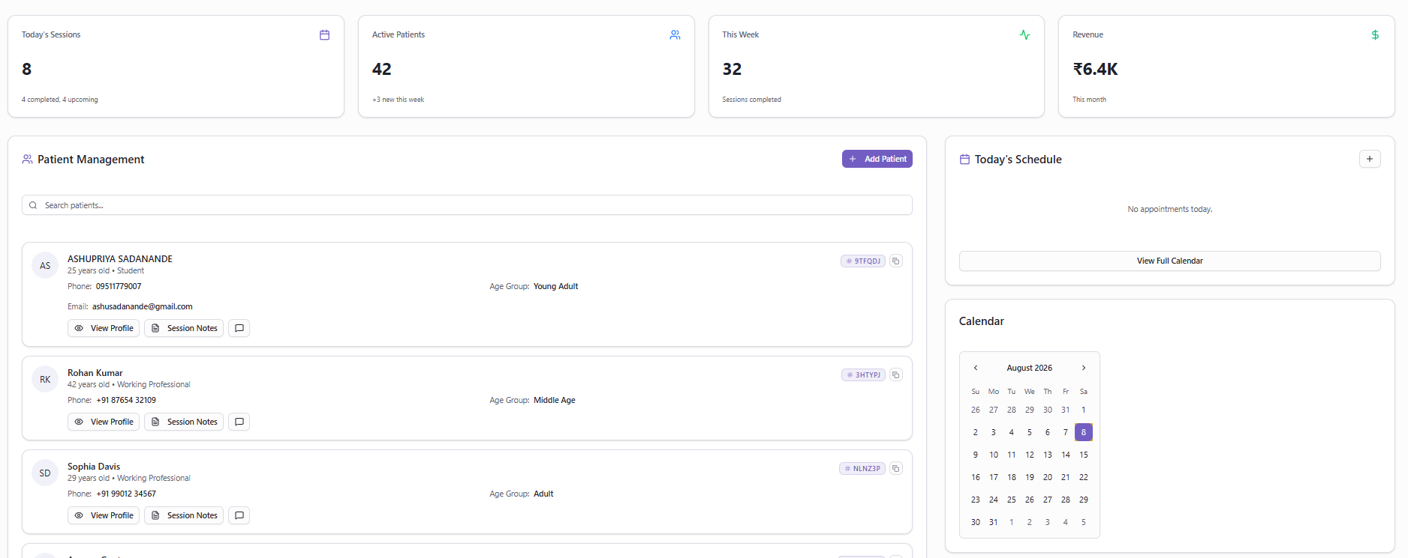
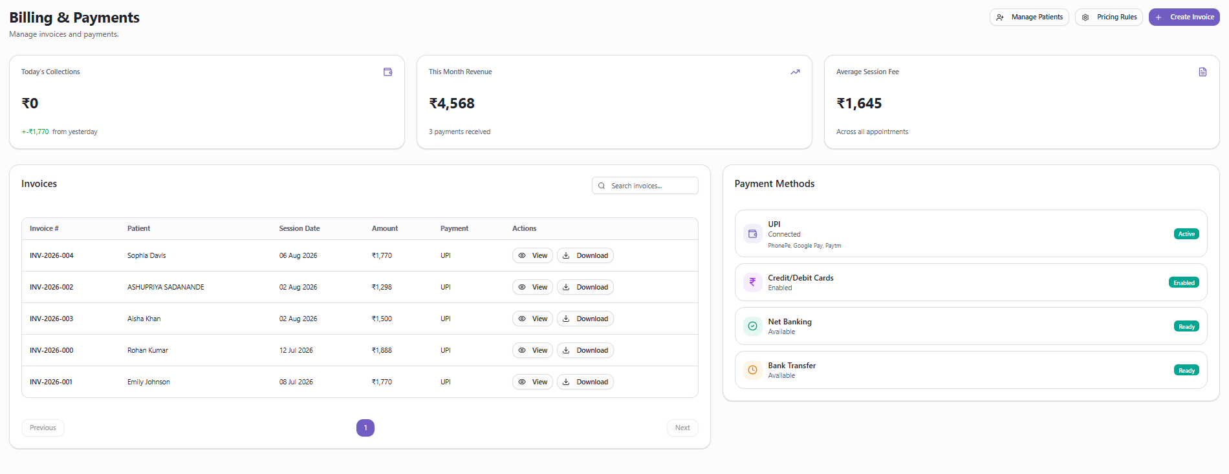
SECTION 04 · DEMO
04
Live Demo
Live URL: https://www.auralyn.space/
Screenshots:

Slide 6
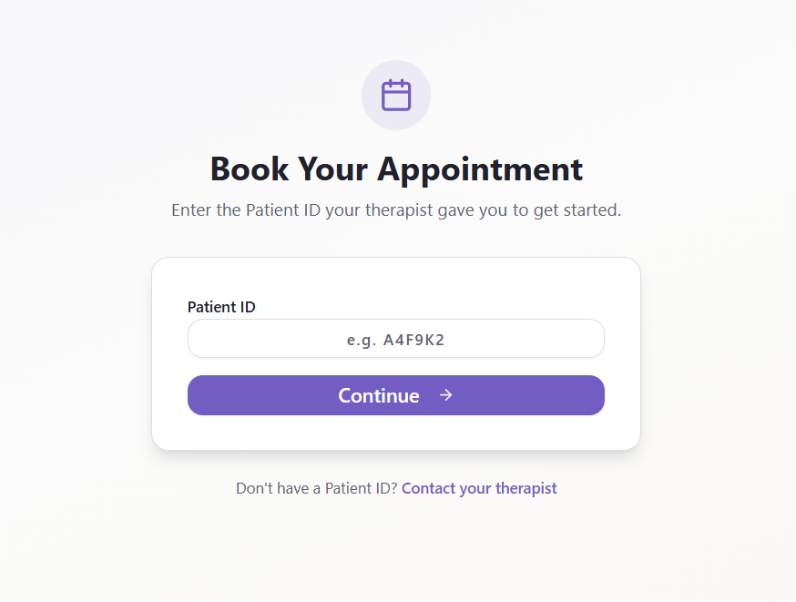
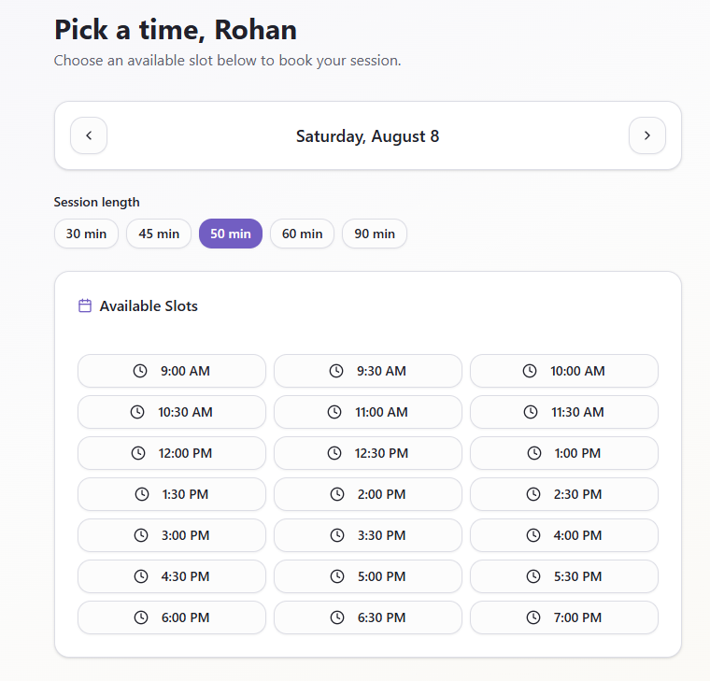
SECTION 05 · STACK
05
Architecture & Stack
Stack: bolt.new + Next.js + Supabase (Postgres, RLS, RPC functions) + [LLM API — TODO]
Flow: User (therapist or patient) → Next.js frontend → Supabase Postgres (atomic book_slot() function) → Realtime dashboard update

Slide 7
SECTION 06 · DECISIONS
06
Key Decisions & Trade-offs
Decision 1: One shared bookings table + atomic locking function over two separate booking systems
Guarantees a walk-in and a patient-app booking can never double-book the same slot, without separate sync logic between two apps.
Decision 2: Auto-generated short Patient ID over requiring patient accounts (email/password)
Independent therapists' clients aren't necessarily tech-first; a therapist-issued code removes the friction of account creation before a first booking.
Decision 3: Rule-based dynamic pricing (age group + profession + duration) over one flat session fee
Matches how independent therapists actually price sessions in practice, and removes manual invoice math and pricing inconsistency.
What surprised while building:
How much of the “AI-sounding” errors were actually plain infrastructure gaps — a Postgres function that was never deployed to the live database kept surfacing as a cryptic “schema cache” error, and the real fix was confirming the migration had actually run, not touching the application code at all.

Slide 8
SECTION 07 · SCOPE
07
What I Cut
Cut: ESG reporting & carbon accounting — because the wedge that gets a therapist to adopt Auralyn is solving day-to-day scheduling and billing pain, not enterprise sustainability reporting.
Cut: Corporate wellness dashboards — because validating the core booking-and-billing loop with individual therapists first mattered more than building a separate B2B buyer motion.
Cut: Native mobile app — because a responsive web dashboard was enough to validate the core workflow without the extra build time of native apps.

Slide 9
SECTION 08 · METRICS
08
How I'd Measure Success
North Star: Appointments successfully booked without conflict (confirmed bookings ÷ booking attempts)
Supporting metrics:
1. Time from patient walk-in / ID entry to a confirmed slot (avg. minutes)
2. Invoices generated within 24 hours of a session (%)
Guardrail metric: Double-booking / slot-conflict rate — must stay at 0%
How I'd instrument it: track booking_attempted, booking_confirmed, and booking_conflict events with timestamps and entry point (walk_in vs patient_app)

Slide 10
SECTION 09 · NEXT
09
What I'd Build Next
Next up: AI-assisted session-note summarization — auto-generating a first-draft summary and flagging notable mood/risk changes after each session
Why this next: Session notes are the most time-consuming manual task after every appointment; automating a first draft saves the most time for the least added complexity.
Evidence that would trigger it: Therapists spending several minutes per session writing notes, or explicitly asking for a summarization/search feature.
Longer term: Expand toward the original vision — corporate wellness, community features, and ESG reporting — once the core practice-management loop has proven adoption among independent therapists.

